Slide 1
Custom Neurons Interface
by Quarta Jonny
Supervisor: Gewaltig Marc-Oliver

Slide 2
Content
Introduction
NEST Structure
What is Cython ?
Interface Structure
Compiling the Neuron
Performances and Optimizations
Problems
Conclusion

Slide 3
Introduction
NEST (NEural Simulation Tool)
Creating custom neurons not flexible
=> create more flexible system
Neurons written in Python

Slide 4
NEST Structure
Simulation Kernel
SLI Interface
CyNEST Interface

Slide 5
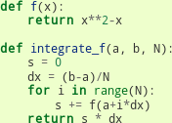
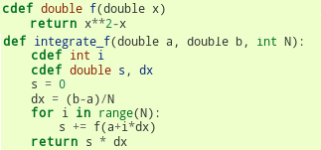
What is Cython ?
Compiling Python code into C/C++
Makes Python code faster

Slide 6
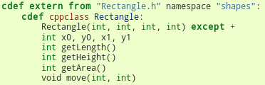
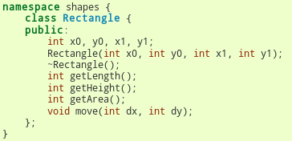
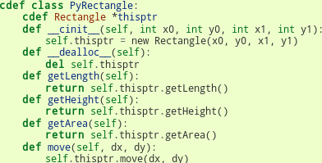
What is Cython ? (2)
Importing C/C++ libraries into Python
Importing Python code into C/C++ !

Slide 7
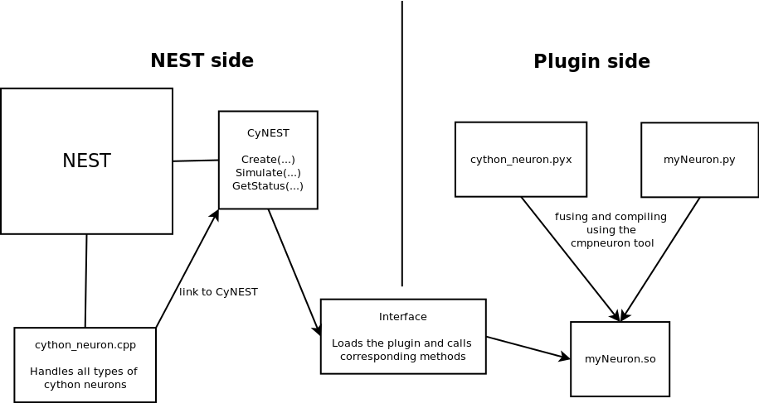
Interface Structure

Slide 8
Basic Neuron Functions
Calibrate()
Update()
GetStatus()
SetStatus()

Slide 9
Interface Details
Library loading for every neuron type (ctypes)
Library contains a list of neurons
=> every C++ neuron has a python counterpart
Status dict vs python fields

Slide 10
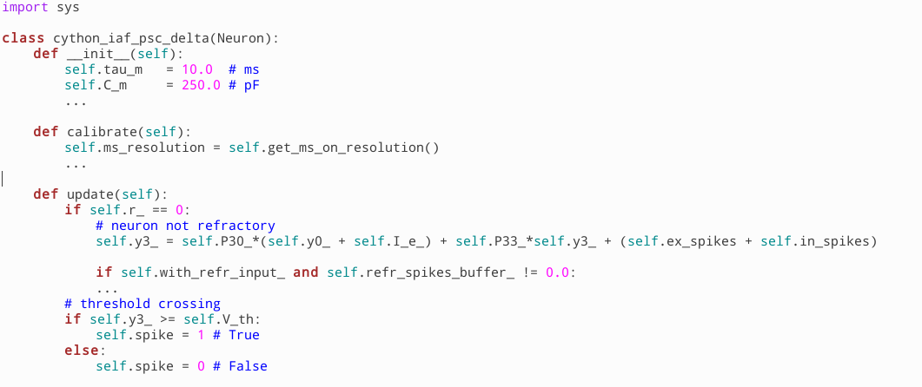
Compiling the Neuron
Compiling with the cmpneuron Tool
Put the result file in a special location

Slide 11
Optimizations
Update method critical
Passing direct pointers
Standard Parameters
  currents
  in_spikes
  ex_spikes
  t_lag
  spike

Slide 12
Performances
Neuron Type | Duration | Nb neurons | Real-time factor
Native | 40 ms | ~1000 | 0.3254
SLI | 40 ms | ~1000 | 0.0046
Cython | 40 ms | ~1000 | 0.0049
=> Cython neuron 66.38 slower than the native,
but slightly faster than SLI

Slide 13
Problems
Project not difficult, but little problems
Cython syntax sometimes confusing
Direct pointer passing not possible
Global Interpreter Lock activated for persistent objects

Slide 14
Conclusion
Useful feature for users
Too slow
Needs some improvements
  Improve speed
  Enable events handling
Other approaches possible
  Highly Configurable Neuron

Slide 15
Questions ?

